Slide 1

MINI PROJECT (CSP-401)
SUBMITTED BY : GARV University Roll No. : 2218750
Class Roll No. : 28 Course/Sem/Section : B.Tech CSE / IV Sem / C2

Slide 2
BRAIN TUMOR DETECTION USING PYTHON

Slide 3
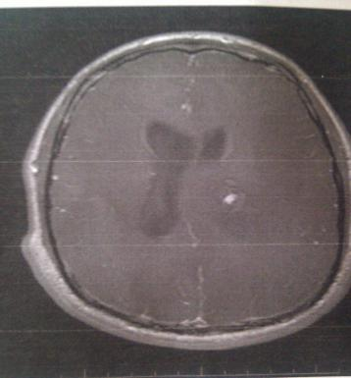
Introduction to Brain Tumor Detection
In the field of medical imaging, using machine learning in Python to detect brain tumors is an important area of research. Machine learning models are being developed to analyze MRI scans and identify the presence of tumors. Early detection and treatment of brain tumors is critical, and these models have the potential to improve patient outcomes.

Slide 4
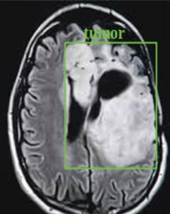
Importance of Early Detection
1
Early Intervention:
2
Improved Prognosis :
Early detection allows for timely intervention, improving patient outcomes and treatment options.
Timely detection of brain tumors can lead to more successful treatment outcomes and higher survival rates.
3
Reduced Complications:
Early identification minimizes the risk of complications and potential adverse effects of brain tumors.

Slide 5
Overview of Machine Learning
in Medical Imaging
Advancements in AI
Enhanced Accuracy
Customized Treatment Plans
Machine learning is being used to analyze medical images for early disease detection, develop personalized treatment plans, and even assist with drug discovery.
AI in medical imaging is getting more accurate through better data, advanced algorithms, combining with doctor's knowledge, and new architectures.
ML in medicine personalizes treatment plans by analyzing vast patient data to predict responses and recommend optimal approaches.

Slide 6
Preprocessing of Brain MRI Images:
1
2
3
Noise Reduction
Contrast Enhancement
Skull Stripping

Slide 7
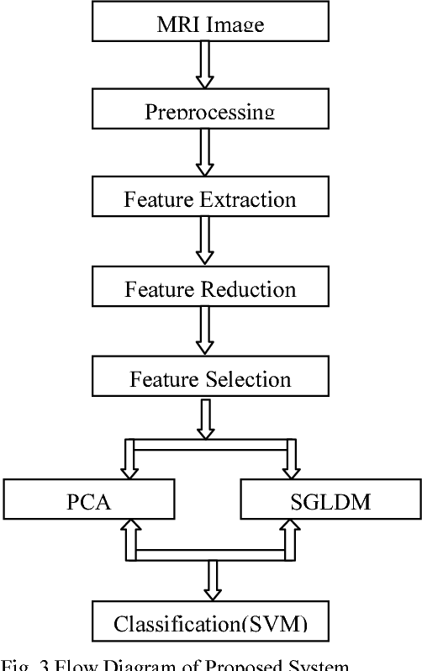
Feature Extraction and Selection
1
Texture Analysis
2
Shape Descriptors
Extraction of textural features aids in identifying tumor-specific patterns within MRI scans.
Features related to tumor shape help in characterizing tumor boundaries and structural details.
3
Intensity Histograms
Quantification of pixel intensities assists in capturing tumor-specific characteristics for analysis.

Slide 8
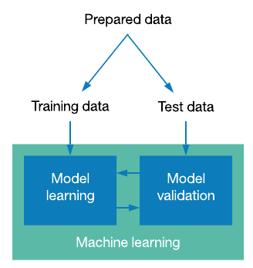
Training and Testing the Machine Learning Model
1
Data Splitting
Division of the dataset into training and testing sets using cross-validation techniques.
2
Model Training
Utilization of algorithms to train the ML model on the labeled MRI data for accurate classification.
3
Evaluation
Assessment of the model's performance in tumor detection using evaluation metrics like accuracy and sensitivity.

Slide 9
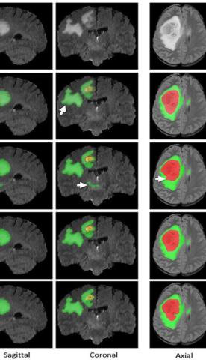
Evaluation Metrics for Brain Tumor
Detection
Accuracy
This is the overall proportion of correctly classified images. It reflects how well the model performs on both positive (tumor present) and negative (tumor absent) cases.
Sensitivity
This metric tells us how good the model is at identifying all the actual tumor cases. A high sensitivity indicates the model rarely misses a tumor.
Specificity
This metric tells us how good the model is at identifying only the actual tumor cases and avoiding false positives (classifying healthy tissue as a tumor).

Slide 10
Conclusion and Future Directions
Enhanced Model Accuracy
Continued improvements in ML algorithms and techniques to enhance the accuracy and reliability of brain tumor detection models.
II. Integration of Advanced Technologies
Exploration of integrating AI with other imaging technologies to improve diagnosis and treatment planning.
III. Personalized Medicine
Focus on developing personalized medicine approaches based on patient-specific imaging data for tailored treatment strategies.

Slide 11
Thank You

